Slide 1
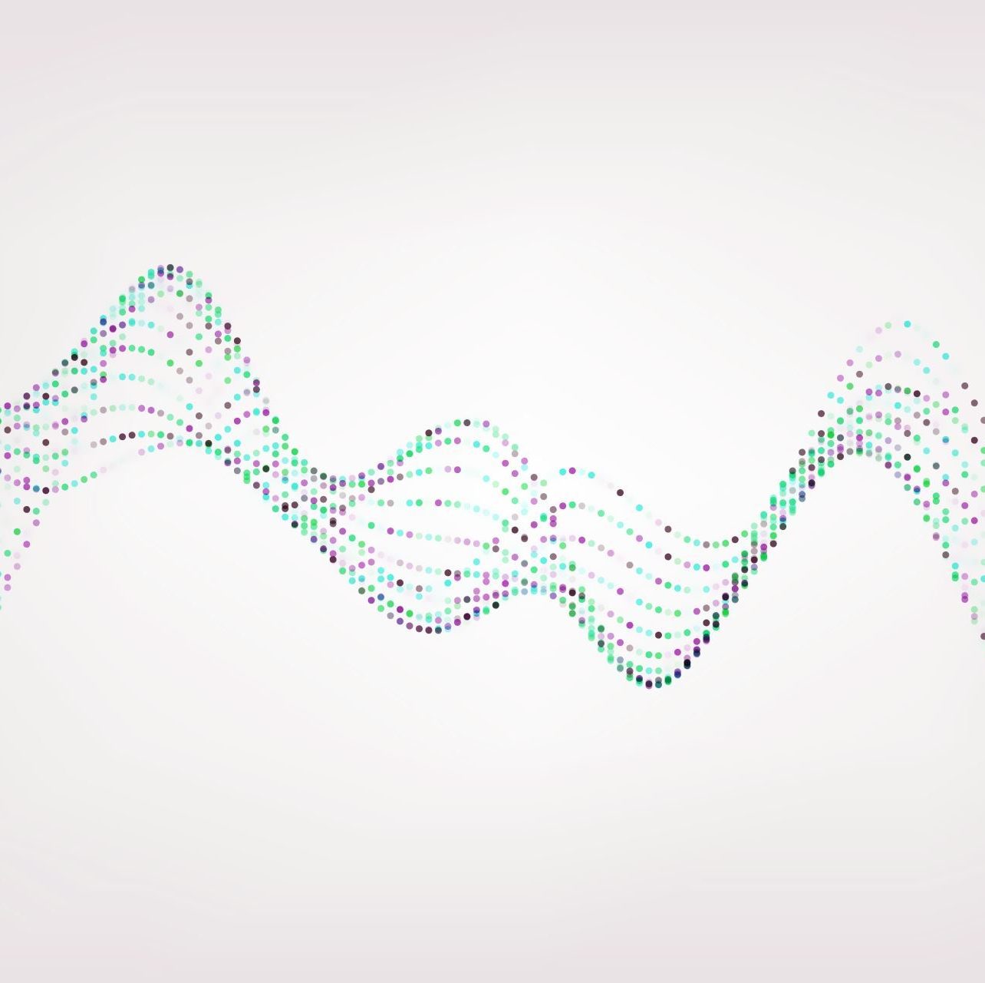
Investigating the Representation Ability of Different Molecular Representations in Solubility Prediction
A Mini Project for CM4044
Done by: Ding Jie, Sherwin and Zhi Chao

Slide 2
Table of contents
Motivations
Materials and methods
Results
Conclusion
Future works

Slide 3
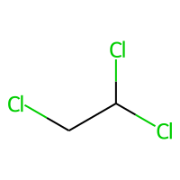
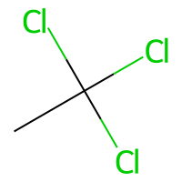
Guessing game: Predict the solubility
VS
-1.48
-2.00
Which has a higher logS?

Slide 4
Motivations
Structural-based representation --> embed structural information into a numerical vector
Molecular representations can be generalised into two methods: 1) Descriptor-based and 2) Structural-based
Heavy computational calculations needed to obtain descriptors useful in prediction tasks
Recent advancement in ML/DL provides architectures that enables such representations
Investigate the representation ability of structural based representation
Explore the use of different regression models for solubility prediction

Slide 5
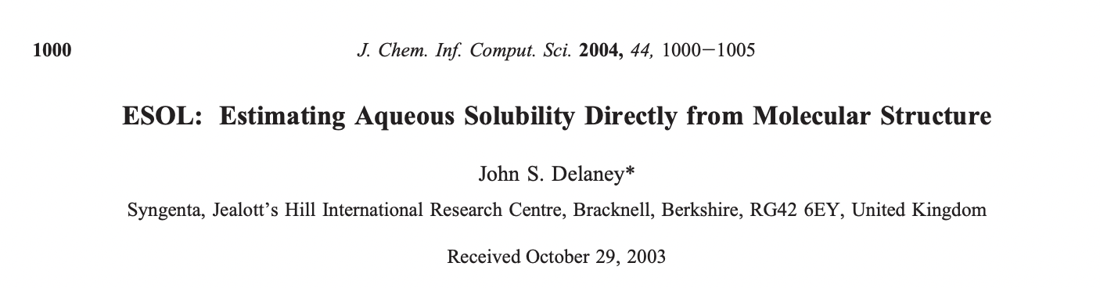
Dataset
Dataset obtained from Delaney et al.
4 columns: Compound ID, actual logS, predicted logS and SMILES
1144 molecules

Slide 6
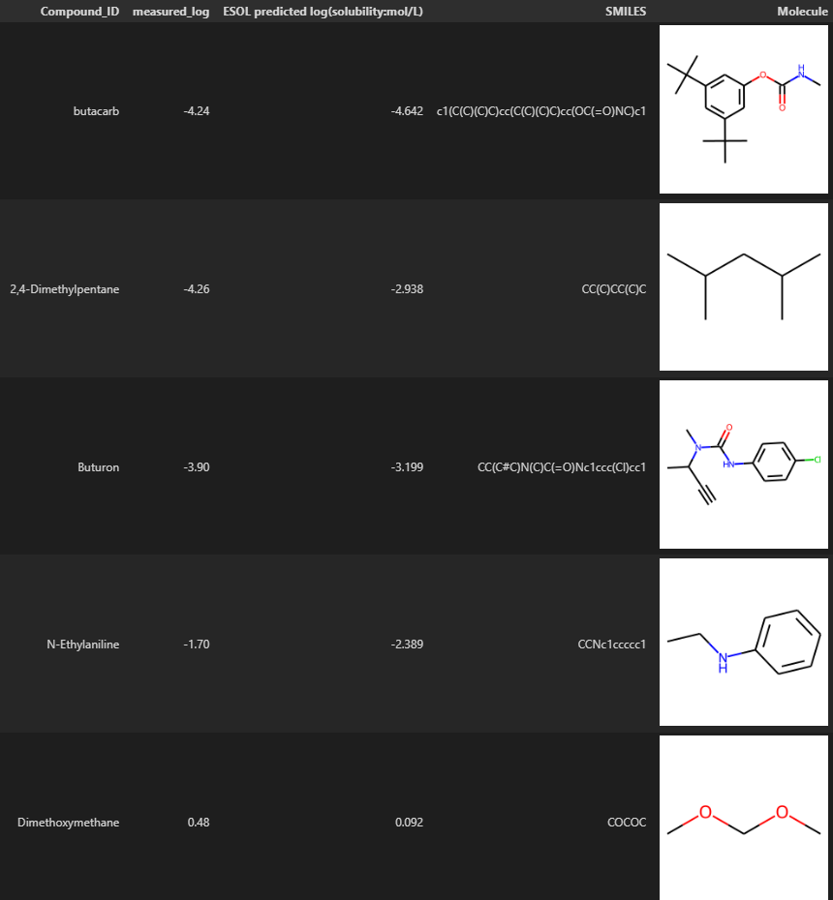
Dataset
Dataset obtained from Delaney et al.
4 columns: Compound ID, actual logS, predicted logS and SMILES
1144 molecules
Notes:
Should show a more “randomised” sample? Maybe 4 or 5 molecule other than 3
Include another picture of the summary table but truncated, count, mean std etc.

Slide 7
Dataset
Dataset obtained from Delaney et al.
4 columns: Compound ID, actual logS, predicted logS and SMILES
1144 molecules
 | measured_log | ESOL predicted log (solubility:mol/L) | mol_wt
count | 1144 | 1144 | 1144
mean | -3.057997 | -2.994776 | 204.631675
std | 2.096502 | 1.686520 | 102.620500
min | -11.600000 | -9.702000 | 16.043000
median | -2.870500 | -2.889000 | 183.59450
max | 1.580000 | 1.091000 | 780.949000

Slide 8
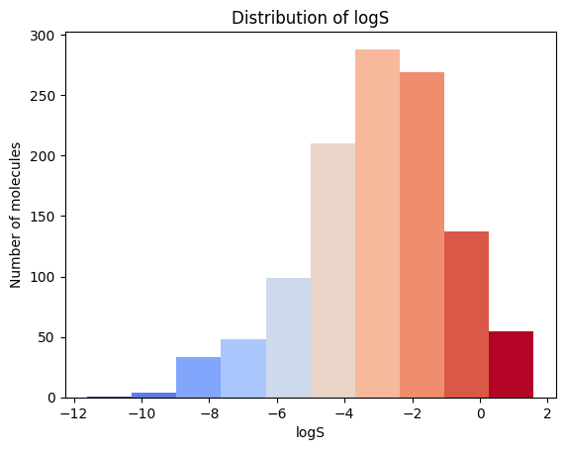
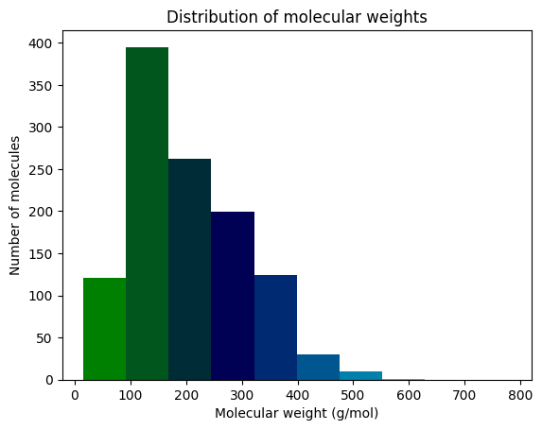
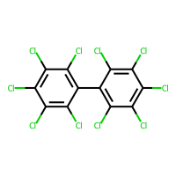
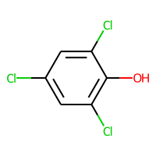
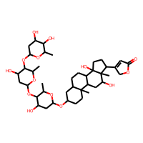
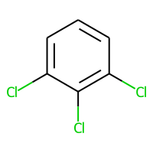
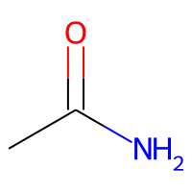
CH₄

Slide 9
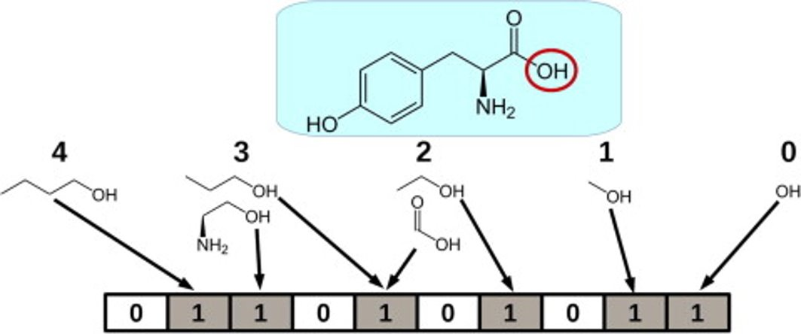
Molecular Fingerprints
Molecules are converted to a bit vector consisting of either 1 or 0
Unlike a structural key, a fingerprint is generated from the molecule’s features
Primarily used in similarity searching, clustering and virtual screening
E.g. RDKit fingerprint and Morgan fingerprint
(Cereto-Massague et al, 2015)
Notes:
Used for comparing similarity also,

Slide 10
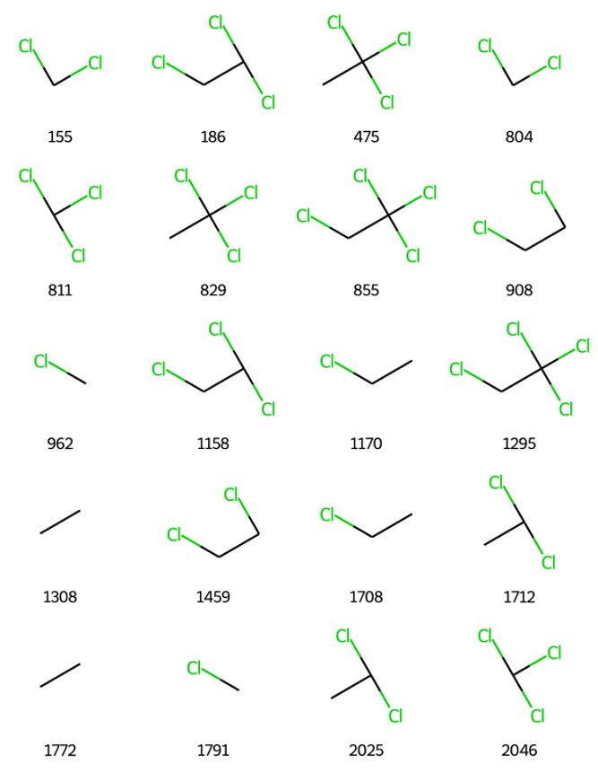
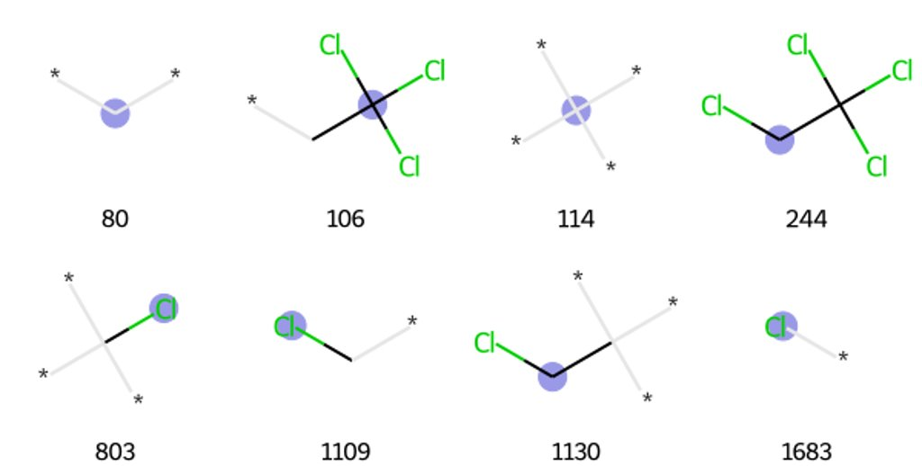
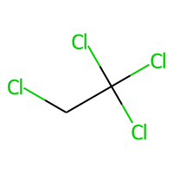
RDKit Fingerprint (1-7 bond length)
Morgan Fingerprint (radius of 2)
Example: 1,1,1,2-tetrachloroethane

Slide 11
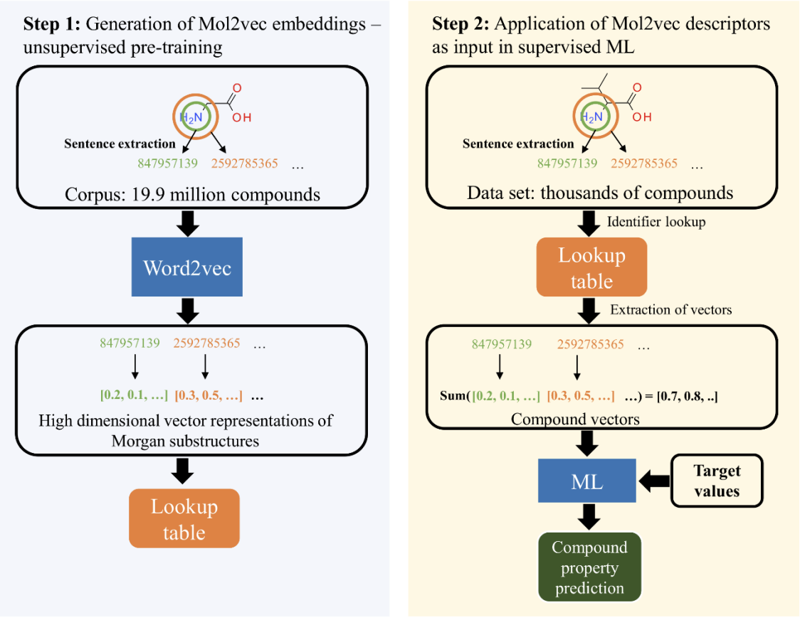
Mol2vec
Developed by Jaeger et al (2)
Inspired by NLP, where words of same context have similar embeddings
Substructures are generated based on Morgan algorithm at radius = 1 and 2
Substructures are passed through Word2vec to obtain vector representations which form a lookup table
Ordered into a “molecular sentence” with the same atom order as present in the canonical SMILES representation
Final molecule vector representation is obtained by summing up all vectors.
(Jaeger et al, 2018)
Notes:
ZC's notes:
Limitations of Extended Connectivity fingerprints (ECFP), or known as Morgan fingerprint, are hashed to a vector with a fixed length. However, the vectors obtained are not only very high dimensional and sparse but also might contain bit collisions introduced by the hashing step, I.e. repeats of the same bits generated by different substructures
Word2vec algo: learns high dimensional embeddings of words where vectors of similar words end up near in vector space
Dataset used from pre-training of the mol2vec and related Protvec involved 19.9 million canonical SMILES representation.
Morgan algorithm used to generate all atom identifiers at radii 0 and 1, 119 and 19831 identifiers respectively
Identifiers of each atom (radius 0 followed by radius 1) were then ordered into a molecular sentence, following the atom order in the canonical SMILES (which is unique)
Rare words (less than 3 times) replaced with UNSEEN string
Used to train word2vec algorithm,
300-dimensional embeddings generated for all combinations
Vector is obtained by summing all vectors of Morgan substructures of the molecule. If unknown identifier occurs during featurisation of new data, UNSEEN vector is employed

Slide 12
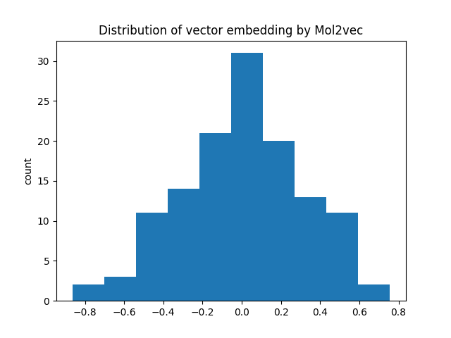
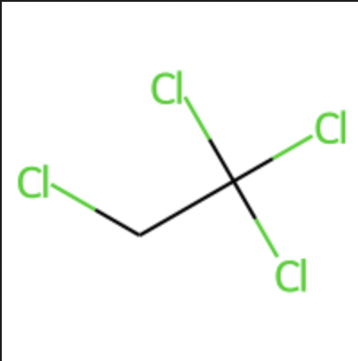
Visualising Mol2vec Representation
1,1,1,2-Tetrachloroethane

Slide 13
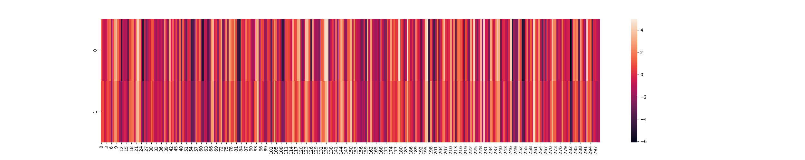
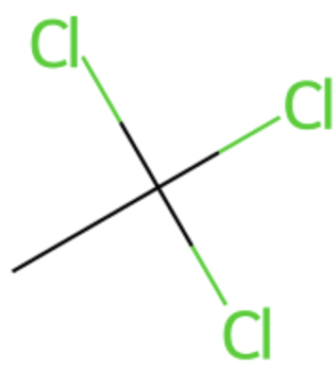
Comparing Between 2 Mol2vec Representations
1,1,1,2-Tetrachloroethane
1,1,1-Trichloroethane

Slide 14
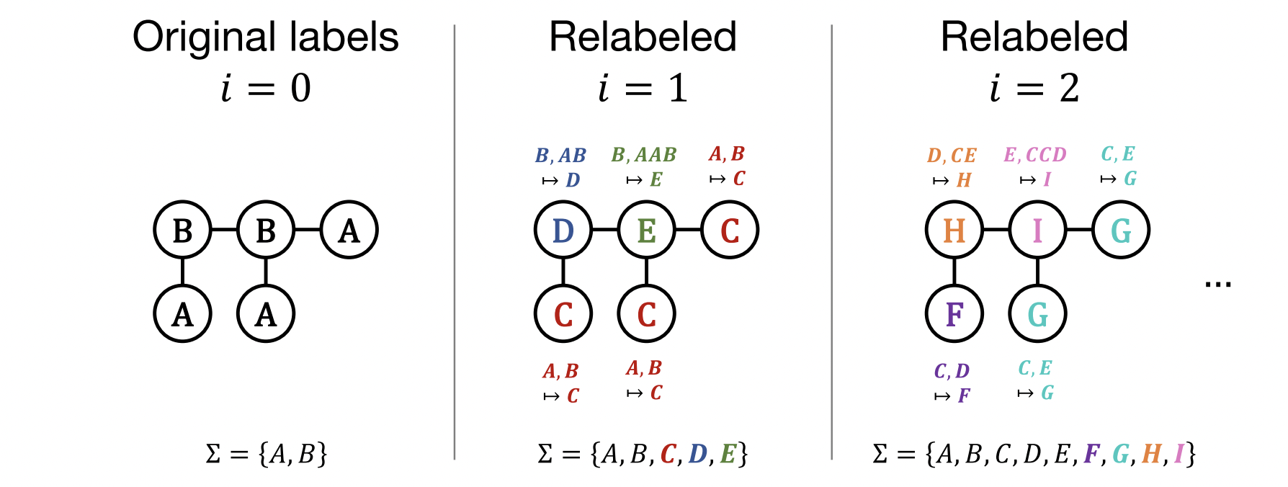
Graph2vec
Developed by Narayanan et al in 2017
NLP inspired where words of same context have similar embeddings
Treat each molecule as a graph, atoms = nodes, bonds = edges
Make use of Weisfeiler-Lehman (WL) algorithm to embed neighboring atoms information to form substructure
Molecules that contains similar substructure will have similar vector representations
(Kriege et al, 2020)​

Slide 15

Visualizing Graph2vec representations

Slide 16
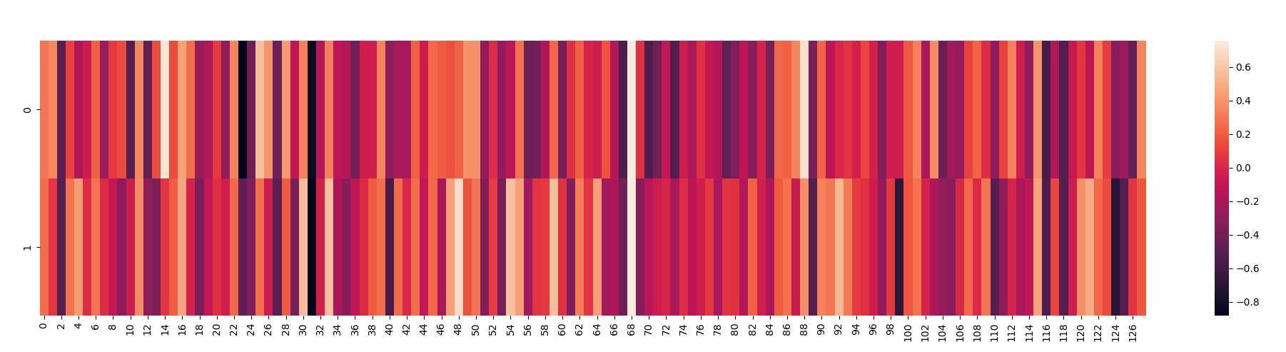
Comparing Between 2 Different Graph2vec Representations
1,1,1,2-Tetrachloroethane
1,1,1-Trichloroethane

Slide 17
Regression Models
Linear Regression
Random Forest Regression
Gradient Boosting Regression
Gaussian Process Regression

Slide 18
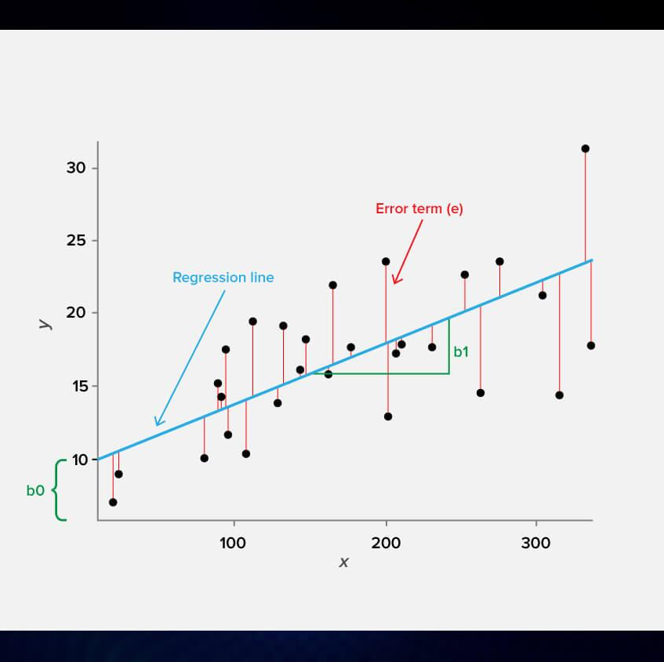
Linear Regression
Simplest regression method
Gradient Descent used to reduce loss function (MSE)
Y = W₀ + W₁X₁ + W₂X₂ + … + W_{p}X_{p} + ε
(Gavrilova, 2020)

Slide 19
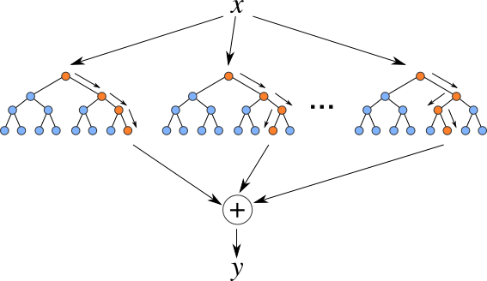
Random Forest Regression
Independent decision trees constructed
Mean of prediction of all trees given as output
Hard to interpret and prone to overfitting
Parameters:
n_estimators
min_sample_split
min_samples_leaf
max_features
bootstrap
(Chaya, 2020)

Slide 20
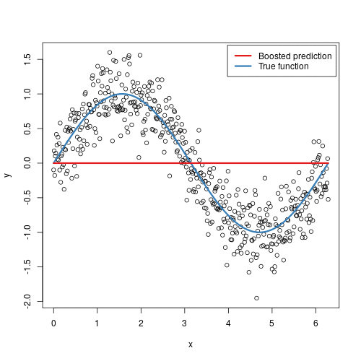
Gradient Boosting Regression
Great ability to determine nonlinear relationships
Multiple weak models are created and combined to reduce loss and improve prediction performance
Parameters:
learning rate
subsample
n_estimators
max_depth
(http://uc-r.github.io/gbm_regression)

Slide 21
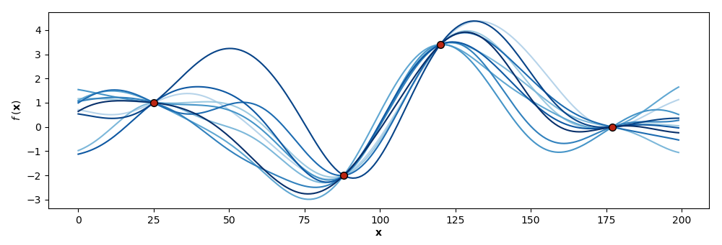
Gaussian Process Regressor
Nonlinear regression tool based on Bayesian probability theory
Able to interpolate between data points scattered in a multi-dimensional input space
Different kernels provided to improve fitting of model
(Gundersen, 2019)

Slide 22

Results

Slide 23
R Squares and MSE
R squares table | Linear regression | Random forest | Gradient boosting | Gaussian Process
RDKit FP | -0.389 | 0.835 | 0.843 | 0.846
Morgan FP | -439 | 0.743 | 0.759 | 0.776
Mol2vec | 0.750 | 0.825 | 0.880 | 0.910
Graph2vec | 0.447 | 0.488 | 0.496 | 0.543
MSE table | Linear regression | Random forest | Gradient boosting | Gaussian Process
RDKit FP | 6.047 | 0.718 | 0.669 | 0.672
Morgan FP | 1.915 x 10¹⁶ | 1.119 | 1.050 | 0.975
Mol2vec | 1.088 | 0.760 | 0.522 | 0.391
Graph2vec | 2.406 | 2.228 | 2.193 | 1.989

Slide 24
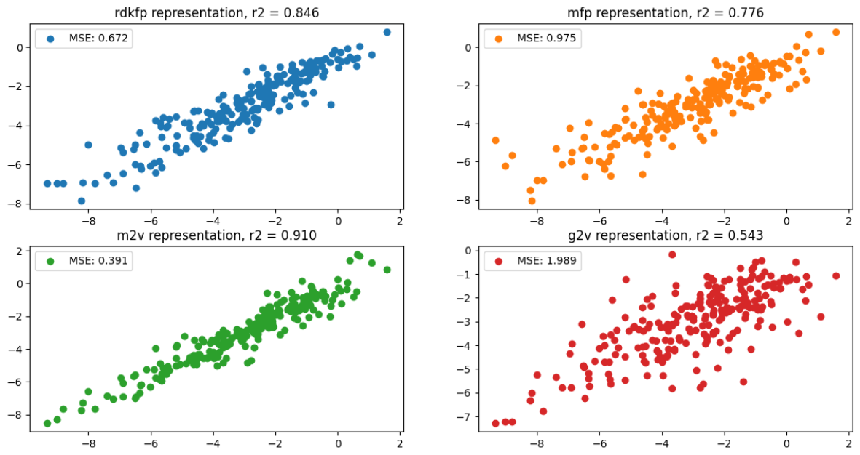
Visualisation (GPR)

Slide 25
Gaussian Process Regression
5-fold CV performed to ensure no overfitting is observed
R squares table | Fold 1 | Fold 2 | Fold 3 | Fold 4 | Fold 5 | Mean | Standard deviation
RDKit FP | 0.79 | 0.83 | 0.84 | 0.77 | 0.84 | 0.82 | 0.028
Morgan FP | 0.77 | 0.75 | 0.77 | 0.74 | 0.75 | 0.76 | 0.012
Mol2vec | 0.92 | 0.89 | 0.89 | 0.89 | 0.91 | 0.90 | 0.012
Graph2vec | 0.52 | 0.56 | 0.53 | 0.46 | 0.54 | 0.52 | 0.033

Slide 26
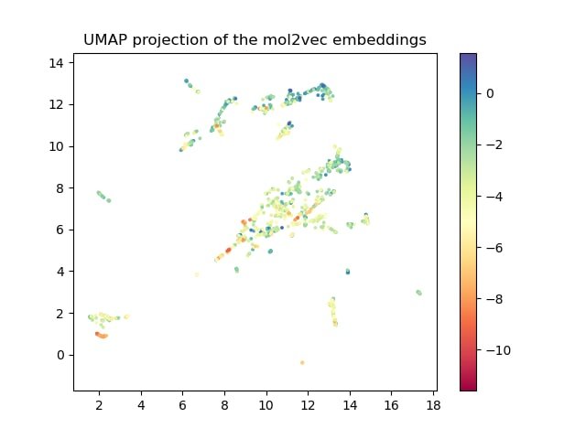
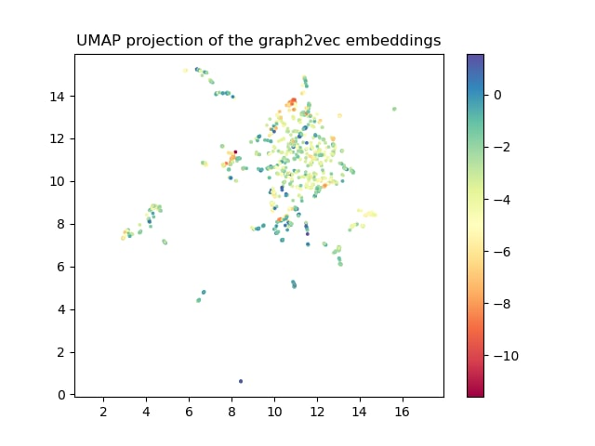
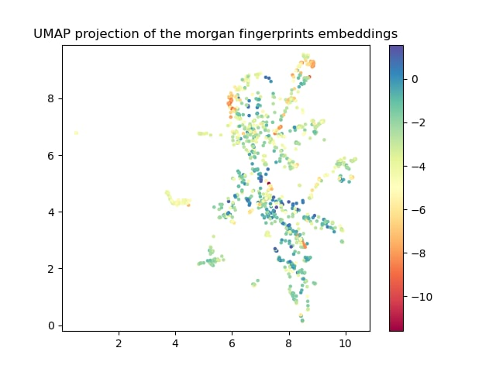
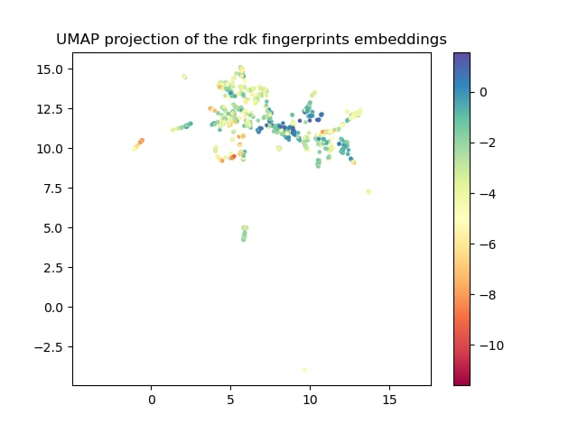
Investigating the Representation Abilities of Embedding Methods

Slide 27

Conclusion
Investigated how well structural-based representations can embed molecules
Compared different regression models for solubility prediction
Mol2vec representation provided the highest R² of 0.91 using the Gaussian Process Regressor model

Slide 28

Future works
More generalization by testing out on a dataset of a larger weight distribution
Replicate work in other prediction task such as classification problems

Slide 29
References
Cereto-Massagué, A.; Ojeda, M. J.; Valls, C.; Mulero, M.; Garcia-Vallvé, S.; Pujadas, G. Molecular Fingerprint Similarity Search in Virtual Screening. Methods 2015, 71, 58–63.
Rogers, D.; Hahn, M. Extended-Connectivity Fingerprints. Journal of Chemical Information and Modeling 2010, 50 (5), 742–754.
Jaeger, S.; Fulle, S.; Turk, S. Mol2vec: Unsupervised Machine Learning Approach with Chemical Intuition. Journal of Chemical Information and Modeling 2018, 58 (1), 27–35.
Narayanan, A., Chandramohan, M., Venkatesan, R., Chen, L., Liu, Y., Jaiswal, S. graph2vec: Learning Distributed Representations of Graphs. 2017
Kriege, N. M.; Johansson, F. D.; Morris, C. A Survey on Graph Kernels. Applied Network Science 2020, 5 (1).
Gavrilova, Y. (2020, September 9). Regression Analysis Overview: The Hows and The Whys. Serokell. https://serokell.io/blog/regression-analysis-overview
Chaya. (2020, June 9). Random Forest Regression. Level Up Coding. https://levelup.gitconnected.com/random-forest-regression-209c0f354c84
Gundersen, G. (2019, June 27). Gaussian Process Regression with Code Snippets. Gregory Gundersen. https://gregorygundersen.com/blog/2019/ 06/27/gp-regression/

Slide 30

Supplementary INfo

Slide 31
RDKit Fingerprint
Each substructure is identified by the bond length dictated by user (1 to 7 by default)
Some substructural information taken into consideration includes type of atoms, bond type etc.
Information is hashed to output a set of bits
Each set of bits are then folded to a 2048-bits vector
Notes:
nBitsPerHash: If this is greater than one, each subgraph will set more than one bit. The additional bits will be generated by seeding a random number generator with the original raw bit ID and generating the appropriate number of random numbers.
Unlike a structural key with its pre-defined patterns, the patterns for a molecule's fingerprint are generated from the molecule itself. The fingerprinting algorithm examines the molecule and generates the following:
a pattern for each atom
a pattern representing each atom and its nearest neighbors (plus the bonds that join them)
a pattern representing each group of atoms and bonds connected by paths up to 2 bonds long
... atoms and bonds connected by paths up to 3 bonds long
... continuing, with paths up to 4, 5, 6, and 7 bonds long.
For example, the molecule OC=CN would generate the following patterns:
0-bond paths:
C
O
N
1-bond paths:
OC
C=C
CN
2-bond paths:
OC=C
C=CN
3-bond paths:
OC=CN
The list of patterns produced is exhaustive: Every pattern in the molecule, up to the pathlength limit, is generated. For all practical purposes, the number of patterns one might encounter by this exhaustive search is infinite, but the number produced for any particular molecule can be easily handled by a computer.
Because there is no pre-defined set of patterns, and because the number of possible patterns is so huge, it is not possible to assign a particular bit to each pattern as we did with structural keys. Instead, each pattern serves as a seed to a pseudo-random number generator (it is "hashed"), the output of which is a set of bits (typically 4 or 5 bits per pattern); the set of bits thus produced is added (with a logical OR) to the fingerprint.
Note that because each set of bits is produced by a pseudo-random generator, it is likely that sets will overlap. For example, suppose we are in the middle of generating a fingerprint, and it happens that 1/4 of the bits are already set. If the next pattern generates a set containing 5 bits, the probability that all 5 bits will be unique is (3/4)5, or about 24%. Likewise, the probability that all 5 bits will not be unique are (1/4)5, or about 0.1%.
In spite of the difference between the meaning of a fingerprint's bits and a structural key's bits, fingerprints share an important feature with structural keys: If a pattern is a substructure of a molecule, every bit that is set in the pattern's fingerprint will be set in the molecule's fingerprint. This means that, like structural keys, we can use simple boolean operations on fingerprints to screen molecules as we search a database, making a fingerprint comparison an extremely fast screen for substructure searching.
The best way to think of the bits of a fingerprint is as "shared" among an unknown but very large number of patterns. Each pattern generates its particular set of bits; so long as at least one of those bits is unique (not shared with any other pattern present in the molecule), we can tell if the pattern is present or not. A structural key indicates with certainty that a particular pattern is present or absent. Fingerprints are not so definite: if a fingerprint indicates a pattern is missing then it certainly is, but it can only indicate a pattern's presence with some probability. Although a fingerprint doesn't indicate with 100% certainty that a particular pattern is present, it contains far more patterns total than a structural key, the net result being that a fingerprint is a far better screen than a structural key in almost all situations.
Fingerprints have several advantages over structural keys:
Since fingerprints have no pre-defined set of patterns, one fingerprinting system serves all databases and all types of queries.
More effective use is made of the bitmap. Structural keys are usually very "sparse" (mostly zeros) since a typical molecule has very few of the patterns that the structural key's bits represent. Although a mathematical analysis of fingerprint density is beyond the scope of this introduction, it turns out that fingerprints can be relatively "dense" (20-40% ones) without losing specificity. The result is that a fingerprint can be much smaller than a structural key with the same discriminating power.
The patterns that go into a fingerprint are highly overlapped - except for "lone atoms", each pattern shares portions of itself with at least one other pattern (the example above illustrates this). The result is that the more complex a molecule gets, the more accurately its fingerprint characterizes it.
FOLDING
The next evolutionary step in screening was the concept of folding a fingerprint to increase information density.
In the discussion above we mentioned the sparseness of a fingerprint, which is directly related to its information density. A fingerprint's information density can be thought of as the ratio how much information it actually holds to how much it could hold. As a practical definition, we measure the bit density, the ratio of "on" bits to the total number of bits (e.g. the bit density of "11000000" is 0.25).
Fingerprints for small molecules and "featureless" molecules (such as CH4 or C40H82) have less information in them than those for large or "rich" molecules. But the fingerprinting mechanisms discussed so far require a fixed fingerprint size for all molecules. If we choose to use small fingerprints, the fingerprint of large or complex molecules will be "black" - nearly all ones - and will not discriminate well (there is more information than the fingerprint can hold). On the other hand, if we use very large fingerprints, most molecules' fingerprints will be "white" - nearly all zeros - and will waste space. In both cases we have low information density; the "black" fingerprint because it is too dense and the "white" one because it is too sparse.
Ideally, we would like to choose a particular discriminatory power (e.g. "For a typical pattern, 98% of the database is screened out by the pattern's fingerprint") and compute the fingerprint density needed to achieve that discriminatory power on a case-by-case basis. Although we can not actually do this, the process of "folding" achieves nearly the same performance and size as the "ideal" case.
The folding process begins with a fixed fingerprint size that is quite large - large enough to accurately represent any molecule we expect to encounter. The fingerprint is then folded: we divide it into two equal halves then combine the two halves using a logical OR. The result is a shorter fingerprint with a higher bit density. We can repeatedly fold the fingerprint until the desired information density (called the minimum density) is reached or exceeded.
As long as two fingerprints are the same size (even if created with different sizes), they are compatible. To see why, consider the fingerprints of a pattern P and a molecule M. If the screen is initially positive (e.g. all bits in the P's fingerprints are also in M's) then the same will be true after folding. On the other hand, a negative screen (at least one bit in P's fingerprint is not in M's) might be converted to a positive screen after folding. But this is ok - converting "correct negative" to a "false positive" doesn't violate the rules of screening: a screen is only required to say P «in» M with 100% reliability. With each fold, we increase the chances of a false positive but save half of the space needed to store the fingerprint.
Fingerprint folding allows us to optimize the information density in a set of fingerprints, thus optimizing screening speed. Rather than choosing one fingerprint size for the entire database, we choose the size of each molecule's fingerprint individually, according to the complexity of the molecule and the desired success rate of the screening process. In most real databases, optimizing the information density greatly reduces the amount of data stored, and increases the screening speed correspondingly.

Slide 32
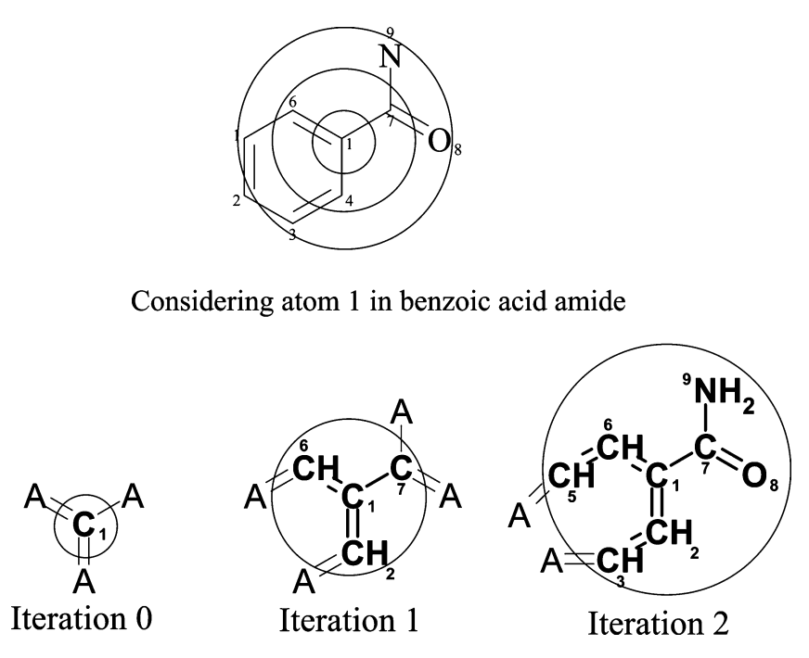
Morgan Fingerprint
Extended circular fingerprint based on Morgan algorithm
Each atom in a molecule can be viewed as the center of a radius of perception
Each center is assigned with a unique identifier which is updated when the neighboring atoms are taken into consideration
A radius of 2 was used in generating a 2048-bit vector to represent the molecule
(Rogers and Hahn, 2010)
https://depth-first.com/articles/2019/01/11/extended-connectivity-fingerprints/#:~:text=The%20core%20idea%20behind%20ECFPs,InChI%20and%20the%20CAS%20Registry.
A Practical Introduction to the Use of Molecular Fingerprints in Drug ...
Notes:
We choose an atom in the molecule and take note of:
number of nearest-neighbour non-hydrogen atoms
number of bonds attached to the atom (not including bonds to hydrogens)
atomic number
atomic mass
number of hydrogens connected to the atom
is the atom in a ring (1) or not (0)?
These values form the Daylight atomic invariants rule.
These values are hashed into an integer. This process is repeated for each atom until all atoms have been assigned a hashed integer value. As an example, this is the result of this process on this arbitrary molecule:
Iteration carried out from first, then second nearest then third nearest neighbours
Duplicate substructures are removed
An array of atom identifiers from each iteration with duplicated removed is then folded to a 2048 bit vector using a hashing algorithm

Slide 33
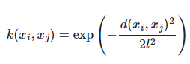
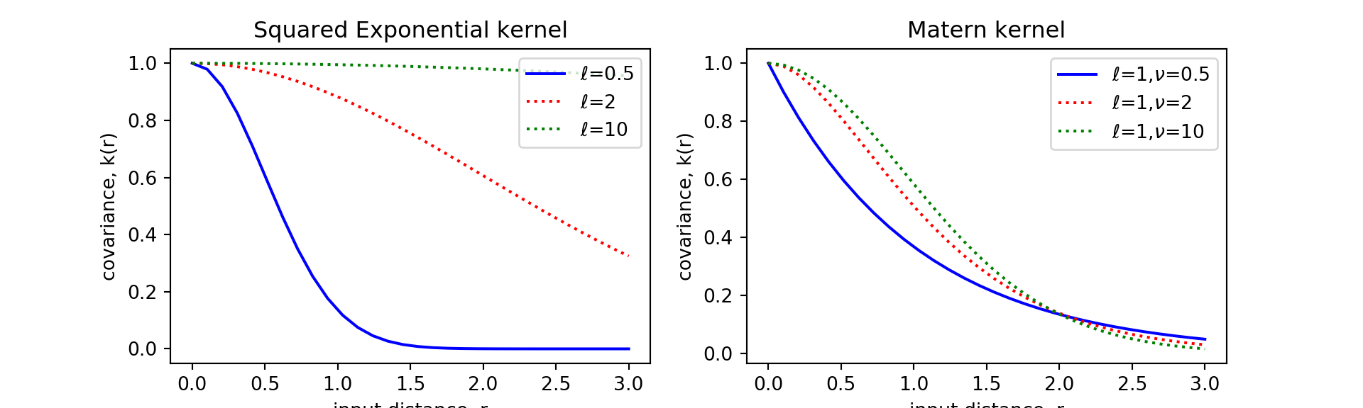
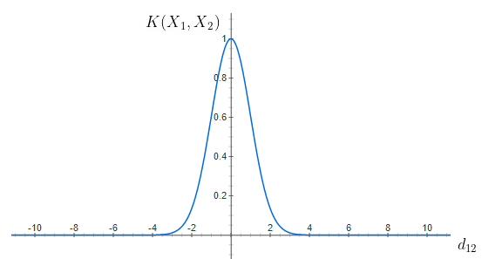
Matern and White Kernel
Radial basis function kernel
When l = 1
Notes:
Implementing Gaussian Process in Python and R · Hao Zhu (zhuhao.org)

Slide 34
MSE and Regression values for GPR
RDKit FP
Morgan FP
Radius | MSE | R Squared
2 | 1.502 | 0.655
3 | 1.026 | 0.764
4 | 0.939 | 0.784
5 | 0.824 | 0.811
6 | 0.723 | 0.834
7 | 0.672 | 0.846
8 | 0.684 | 0.843
9 | 0.665 | 0.847
10 | 0.686 | 0.843
Radius | MSE | R Squared
2 | 0.975 | 0.776
3 | 1.072 | 0.754
4 | 0.990 | 0.773
5 | 0.955 | 0.781
6 | 0.934 | 0.785
7 | 0.934 | 0.786
8 | 0.928 | 0.787
9 | 0.929 | 0.787
10 | 0.930 | 0.786

Slide 35
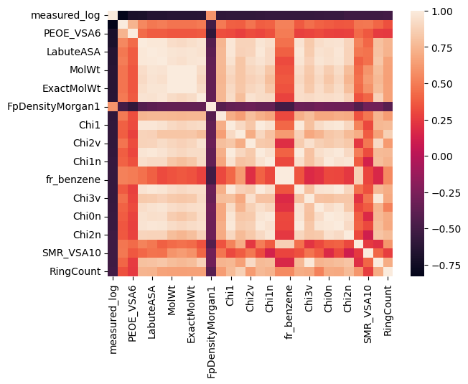
Correlation matrix
Molecular descriptors generated using RDkit
29 out of 207 descriptors shows >0.5 correlation with measured solubility values

Slide 36
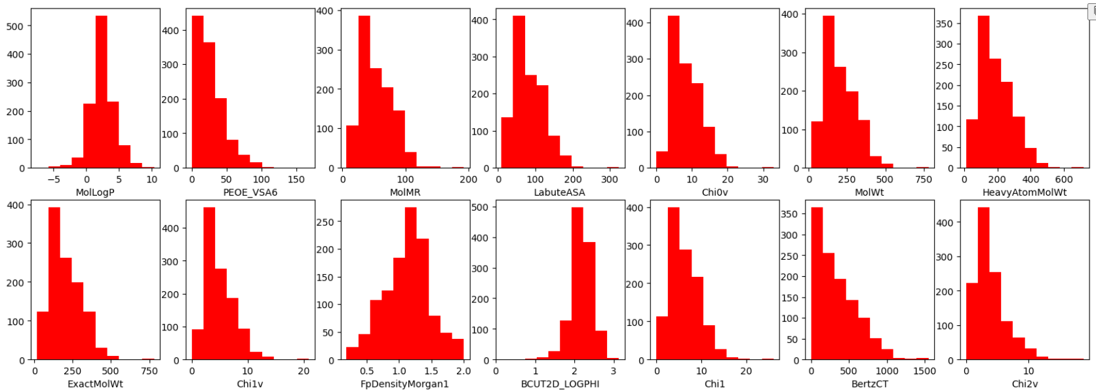
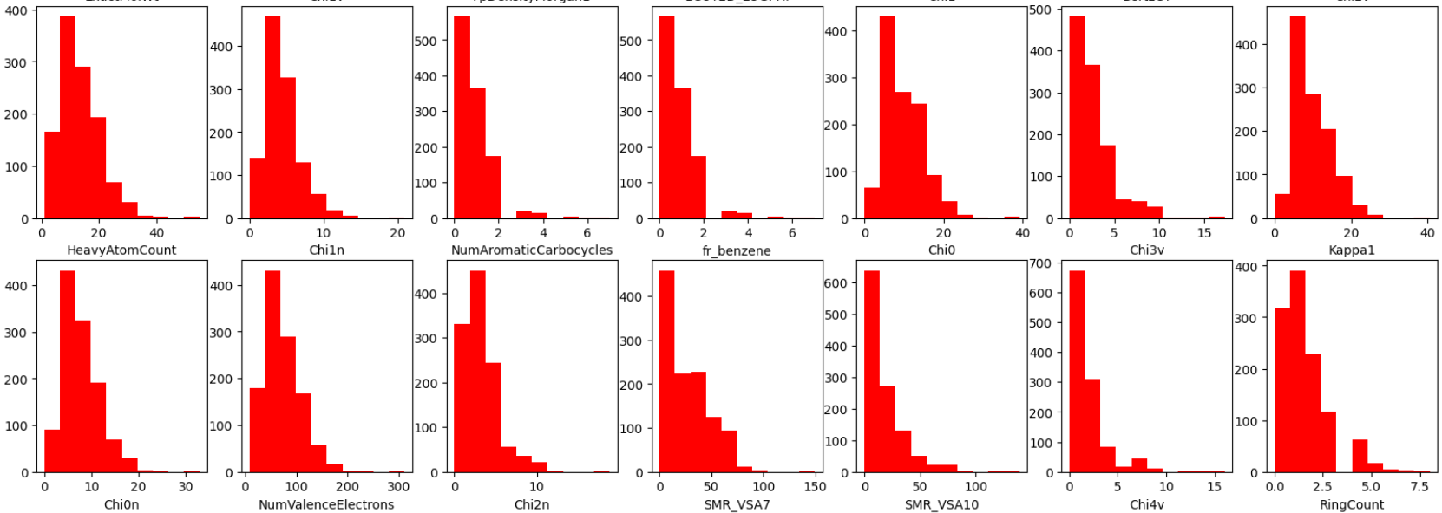
Property distribution

Slide 37
Type of Descriptors Used
General descriptors | Molecular surface area descriptors | Topological / topochemical descriptors | Fragments descriptors | Lipinski parameters for molecules
MolWt Exact MolWt FpDensityMorgan1 | Labute ASA PEOE_VSA6 SMR_VSA10 | Ch1 Chi2v Chi1n Chi3v Chi0n Chi2n | Fr_benzene | Ring count
Notes:
FP densityMorgan1: radius 1 morgan fingerprint density
Molwt is average, exact mol weight is exact
ASA: accessibile surface area for a solvent around a molecule, slightly bigger than van der waals surface in general
Van der waals surface area: a surface might reside for the molecule based on the hard cutoffs of Van der Waals radii for individual atoms, and it represents a surface through which the molecule might be conceived as interacting with other molecule
PEOE VSA6: MOE Charge VSA Descriptor 6 (-0.10 <= x < -0.05)
SMR_VSA10: MOE MR VSA Descriptor 10 ( 4.00 <= x < inf)
Topo descriptors: calculated using molecular graph theory as per the Reviews in Computational Chemistry book.
Frbenzene: number of benzene rings
Ring count: number of rings

